Slide 1
Bereaved children and young people in Leeds schools… what are we doing to help?

Slide 2
Schools:
Ensure that schools reflect on provision support around bereavement
Developed new questions around bereavement to be included in the My Health My School Survey, for pupils in year 5, 6, 7, 9 & 11, in order to capture city wide bereavement data

Slide 3
Schools:
Offer training and support to schools on responding to, and dealing with, bereaved children and their families
Support schools in developing a bereavement policy
Ensure death education is embedded in the curriculum

Slide 4
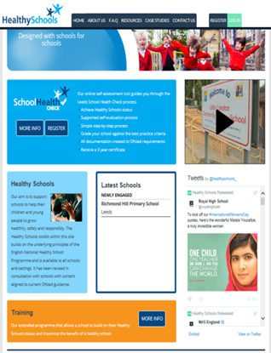
Healthy Schools Status:
The School Health Check

Slide 5
Sections
1.Leadership
2.Policy
3.Curriculum
4.Teaching & Learning
5.Assessment
6.Pupil Voice
7.Support Services
8.Professional Development
9.Partnerships
10.School Ethos

Slide 6
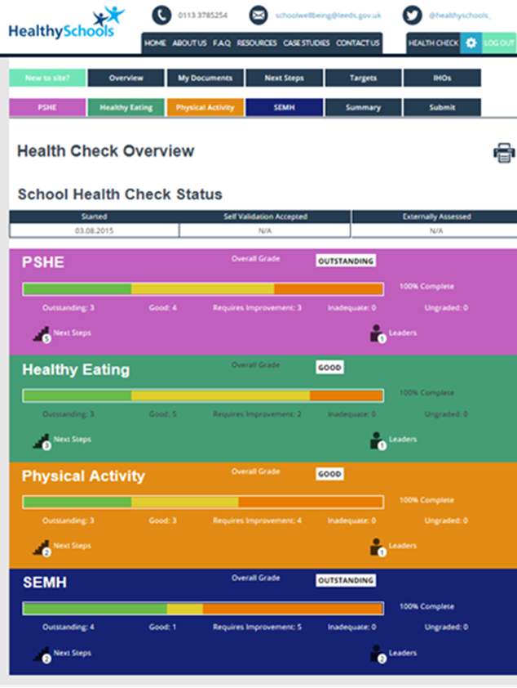

Slide 7
Leadership:
Relevant members of the staff team, including SLT, have attended SEMH training and have a clear understanding of effective whole school approaches and specific emotional wellbeing and mental health needs, e.g. loss and bereavement and self harm.

Slide 8
Policy Development:
The school has an effective policy to support staff and pupils in times of bereavement, crisis or trauma, and the practice is well understood and valued by all.
All policies linked to SEMH, e.g. anti-bullying, bereavement, wellbeing policies, are all regularly monitored and evaluated for impact. They are subject to a planned review cycle including a regular survey to all stakeholders and are policies in practice.

Slide 9
Teaching and Learning:
All teachers are confident and skilled in discussing sensitive and/or controversial issues in lessons, such as self- harm and bereavement, with clear and consistent ground rules.
Pupils demonstrate that they have excellent emotional literacy skills and a good understanding of how to recognise and deal with mental health problems such as stress, eating disorders, self-harm or bereavement. They demonstrate that they know how to develop resilience and resist peer pressure and where to go to seek further help and advice.

Slide 10
www.myhealthmyschoolsurvey.org.uk
11th Year
All Schools need to re-register !!
2016-17
117 schools completed the survey
Primary – 6360
Secondary – 4554
Total - 10914
¼ of the NOR population completed the survey
www.myhealthmyschoolsurvey.org.uk
Live Oct 2017
Notes:
January 2016
As part of the current inspection framework Ofsted must have regard to the views of pupils (through surveys) and local data when making their overall judgements of the school, specifically when evaluating the effectiveness of the PSHE curriculum and the impact of the new Primary PE and Sport funding. This online survey has been created with this in mind, to measure the effectiveness of the work in schools and to support staff in evidencing the impact of their Healthy Schools’ work.
Developed by the Health & Wellbeing Service
Replaces the ECM/GUIL Survey
Pilot in 2006/07 followed by 8 years full implementation
Reflects national and local policy issues
The survey remains FREE to use for all schools
The survey is an online anonymous pupil survey for pupils in years 5, 6, 7, 9, & 11
Live January 2016
In 2016 the survey offers a range of additional benefits:
New questions – British Values - plus others

Slide 11
Sections
Healthy Eating
Social, Emotional & Mental Health
PE, School Sport and Physical Activity
Drugs, Alcohol & Tobacco
Sexual Health
Safety & Anti-bullying
My School

Slide 12
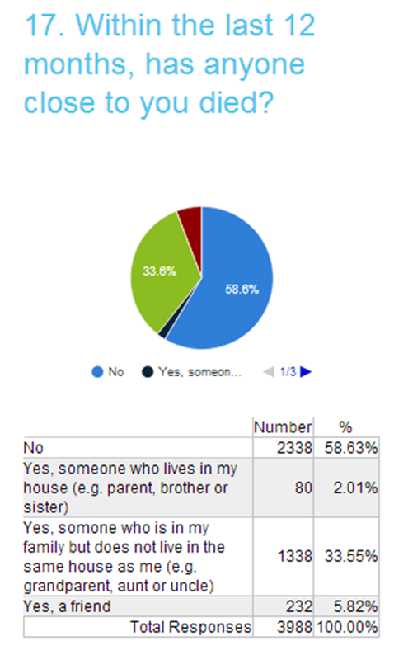
My Health My School Survey

Slide 13
Within the last 12 months, has anyone close to you died?
Yes – someone who lives in my house (e.g. parent, brother, sister):
Years 7, 9 & 11
2.57% (117 pupils)
Year 5 & 6
2.72% (173 pupils)

Slide 14
If you needed it, were you supported by school to help you deal with this death?
No, I had no support from either my school or anywhere else:
Years 7, 9 & 11
11.93% (169 pupils)
Year 5 & 6
5.77% (154 pupils)

Slide 15
Which of the following things do you worry about the most? (Multi response – tick all that apply)
A death:
Years 7, 9 & 11
9.97% (1277 pupils)
Year 5 & 6
5.05% (878 pupils)
Notes:
Primary – thing worry about the most

Slide 16
How much useful information and learning have you had to help you understand the following things (e.g. through lessons at school)
I have had enough useful information:
Years 7, 9 & 11
34% (1538 pupils)
Year 5 & 6
41.49% (2602 pupils)

Slide 17
To make sure you are safe and healthy, would you know where to go to get help and advice for each of these things:
How to cope with a death: No
Years 7, 9 & 11
36.08% (1629 pupils)
Year 5 & 6
29.01% (1845pupils)
Notes:
Mindmate website

Slide 18
Bereavement Policy:
Key Sections include:
Language and answering questions
Bereavement Education programme
Support for staff, pupils and families
Procedures when a death occurs
Considerations e.g. on going remembrance,
returning to school, transition, reactions , self-care
Parents, carers and families

Slide 19
Death in the primary curriculum:
Year 1
Pupils learn about change or loss and how this can feel:
Pupils are able to give an example of when people might experience change or loss (for example, a lost toy, when a pet dies, moving home or school)
Pupils can describe how people might feel when there is a change or loss
Pupils recognise what they can do to help themselves or someone else who may be feeling unhappy

Slide 20
Death in the primary curriculum:
Year 5
Pupils learn about the feelings associated with loss, grief and bereavement:
Pupils recognise that at times of loss, there is a period of grief that people go through
Pupils understand there are a range of feelings that accompany bereavement and know that these are necessary and important
Pupils know some ways of expressing feelings related to grief

Slide 21
SEMH MindMate lessons www.mindmatechampions.org.uk

Slide 25
Contacts :
Helen Smithies, Healthy Schools & PSHE Consultant (ENE)
07891 279418
helen.smithies@leeds.gov.uk
www.schoolwellbeing.co.uk
www.healthyschools.org.uk

