Slide 2
Signposting
We signpost individuals to the most appropriate bereavement service either locally or nationally. You do not need to be referred to us, our service is free and open to all

Slide 3
Support
We provide training, information, events and conferences to people who work in the area of bereavement to support their professional development. We work in partnership with organisations across the city to improve the provision of bereavement services

Slide 4
Campaigning
We campaign to help people talk more openly about dying, death and bereavement and to make plans for the end of life. We work in partnership with Dying Matters nationally and locally

Slide 5
2018 Monthly Talks
28 February | Ruth Penfold-Mounce | Senior Lecturer in Criminology, University of York | Celebrity Death and Public Grieving
21 March | Dr Anita Sargeant | Head of the School of Allied Health Professions, University of Bradford | (In)visible loss across the life course for LGBTQ+ people and communities
18 April | Patrick Bourne | Community Curator, Abbey House Museum | Remembrance : A talk about Abbey House Museum’s exhibition
23 May | Stuart Todd | Senior Lecturer in Learning Disability Nursing, University of South Wales | Silenced Bereavement – Death Dying and Learning Disabilities
27 June | Angela Morgan | Ethical Tissue Research Nurse, University of Bradford | Tissue donation after death: a vital contribution to medical research
25 July | Rev Andrew Goodhead | Spiritual Care Lead, St Christopher’s Hospice | The dead shall live: memorialising in modern Britain
All our FREE talks take place from midday till 1pm at Oxford Place Centre, Leeds LS1 3AX – all welcome

Slide 6
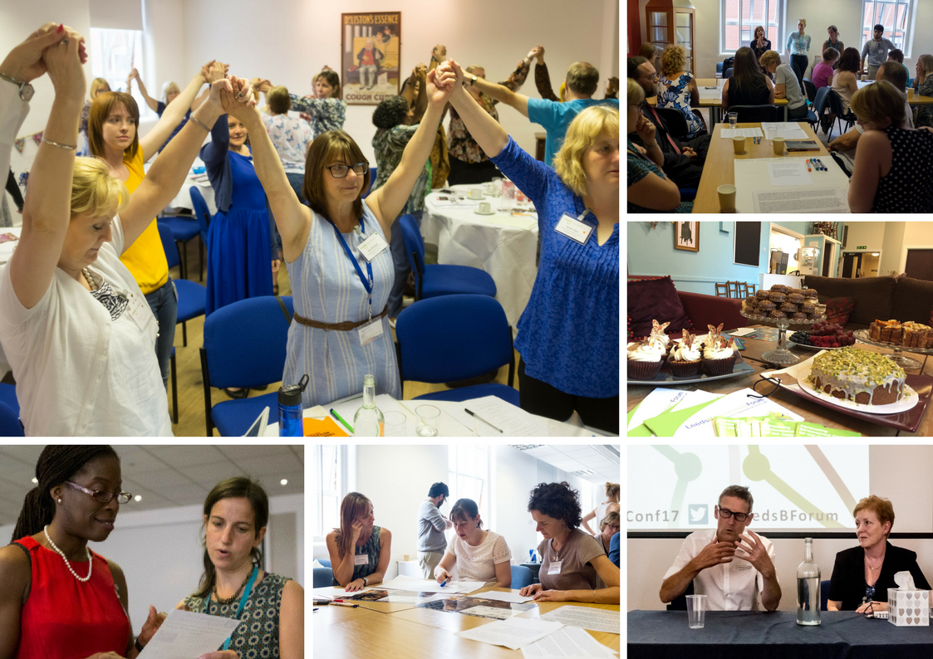

Slide 7
Get in touch
Website | www.lbforum.org.uk
Email | info@lbforum.org.uk
Telephone | 0113 225 3975
Twitter | @LeedsBForum #LBFConf18
Facebook | www.facebook.com/
LeedsBereavementForum
Registered Charity No. 1093311

